Slide 1
Title: Write a program in solidity to create Student data. Use the following constructs:
Structures
Arrays
Fallback
Observe the transaction fee and Gas values.

Slide 2
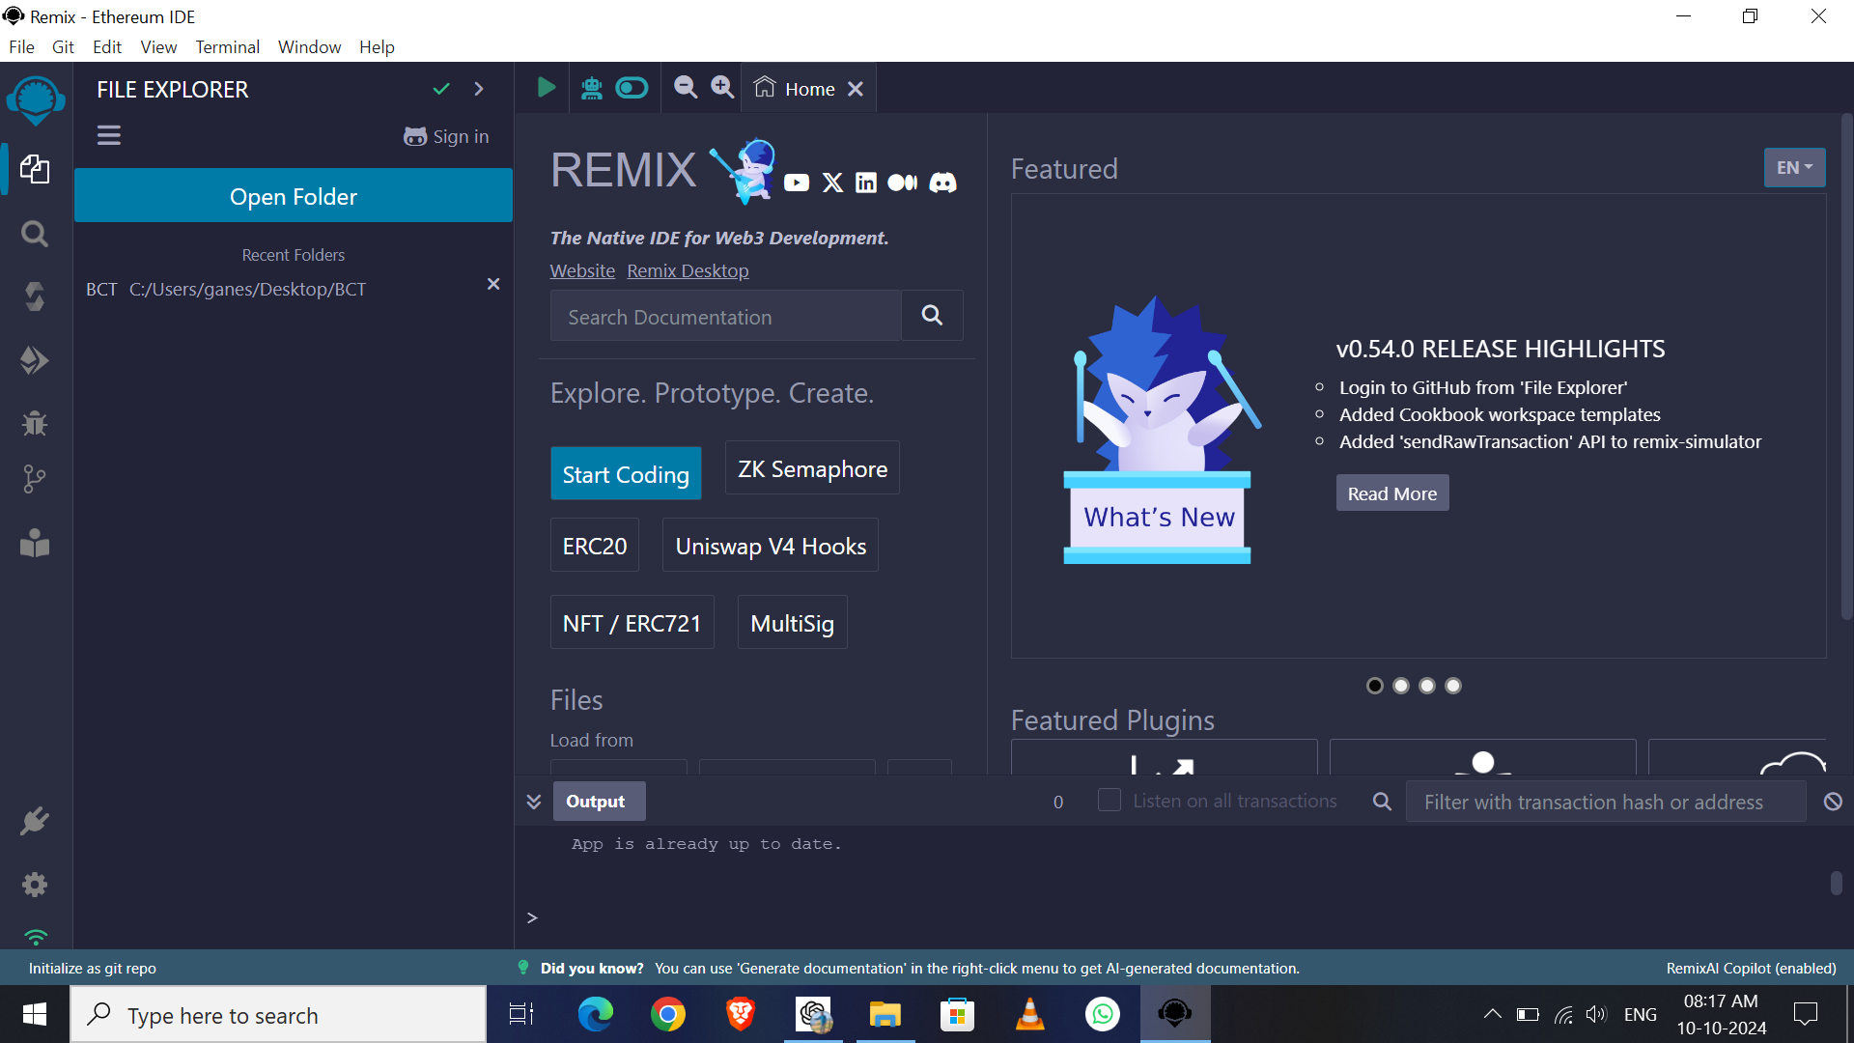

Slide 3
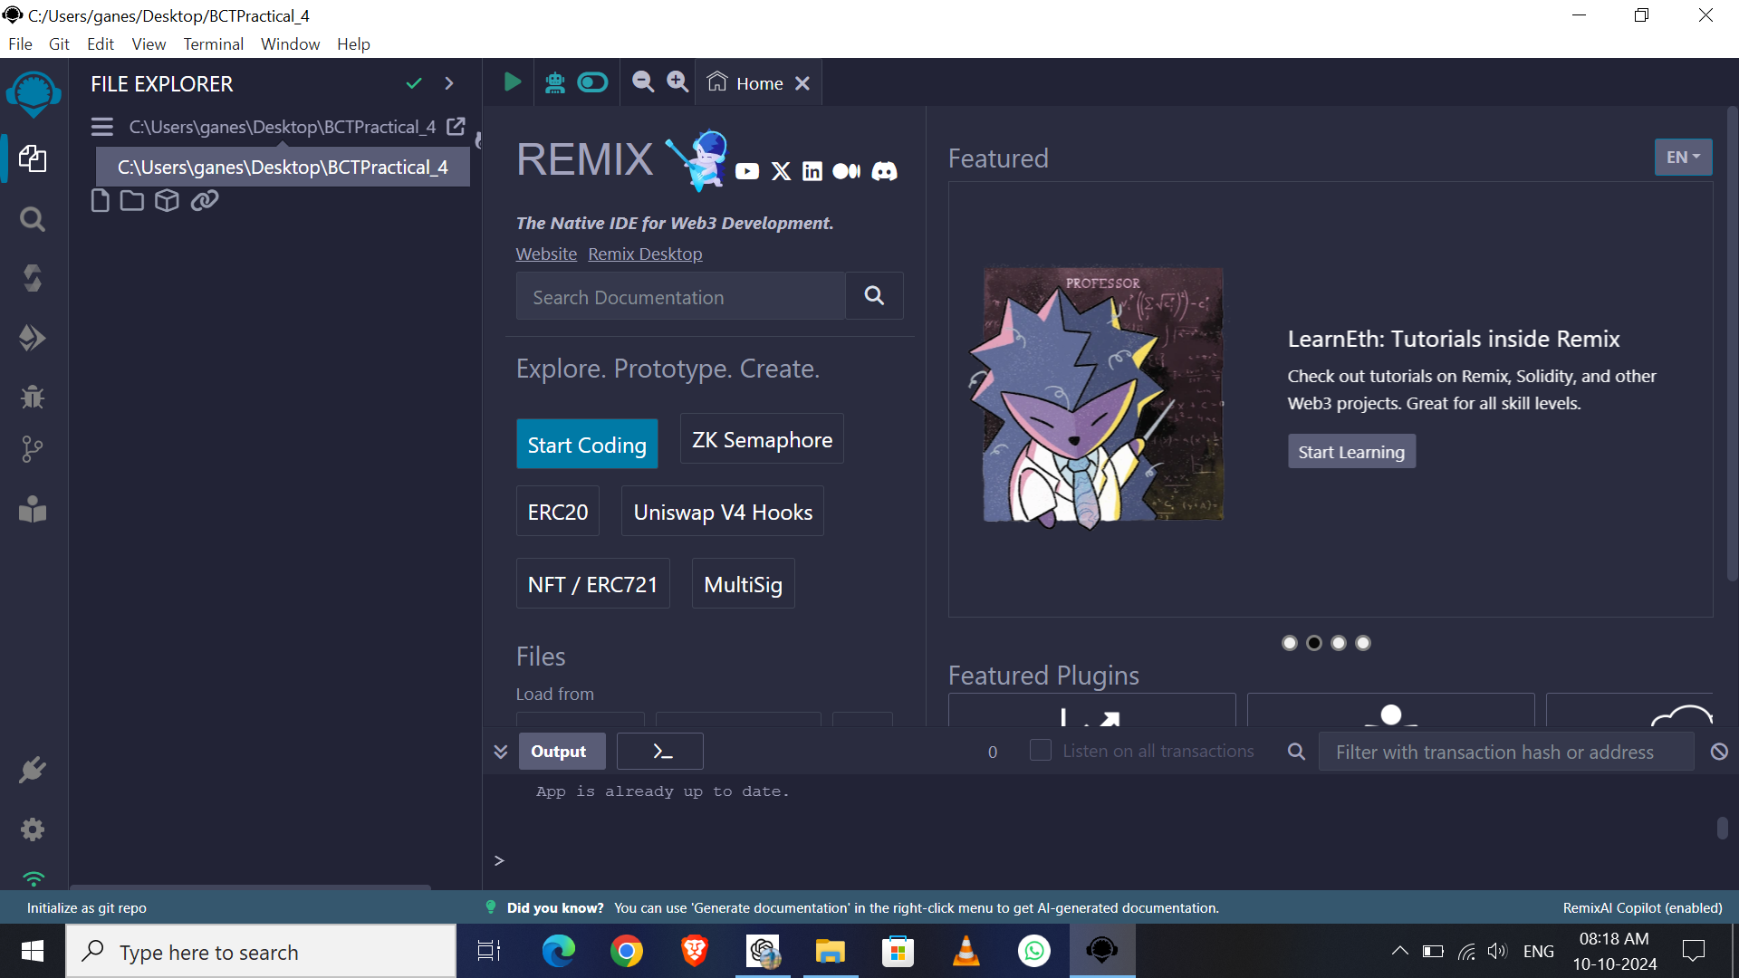

Slide 4
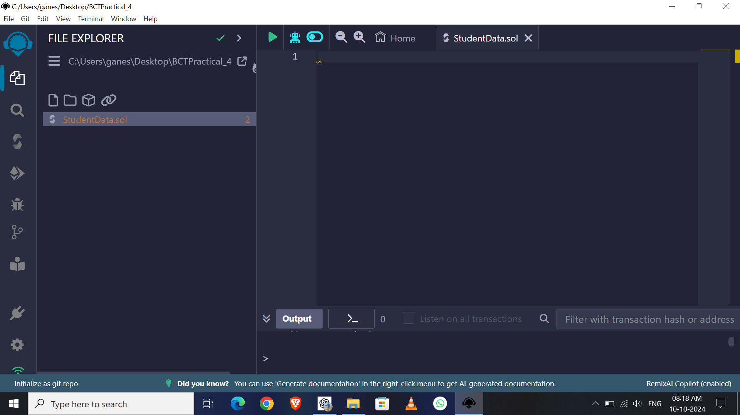

Slide 5
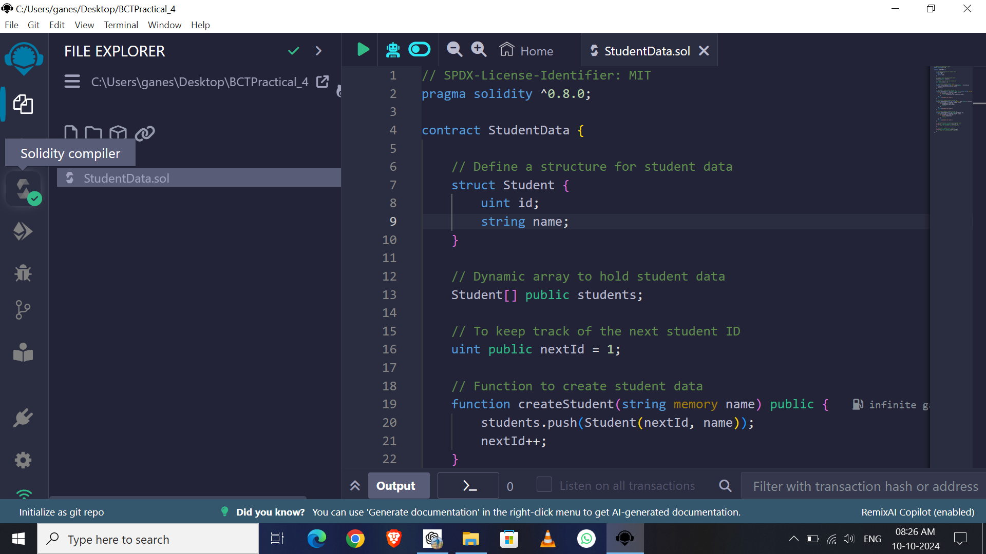

Slide 6
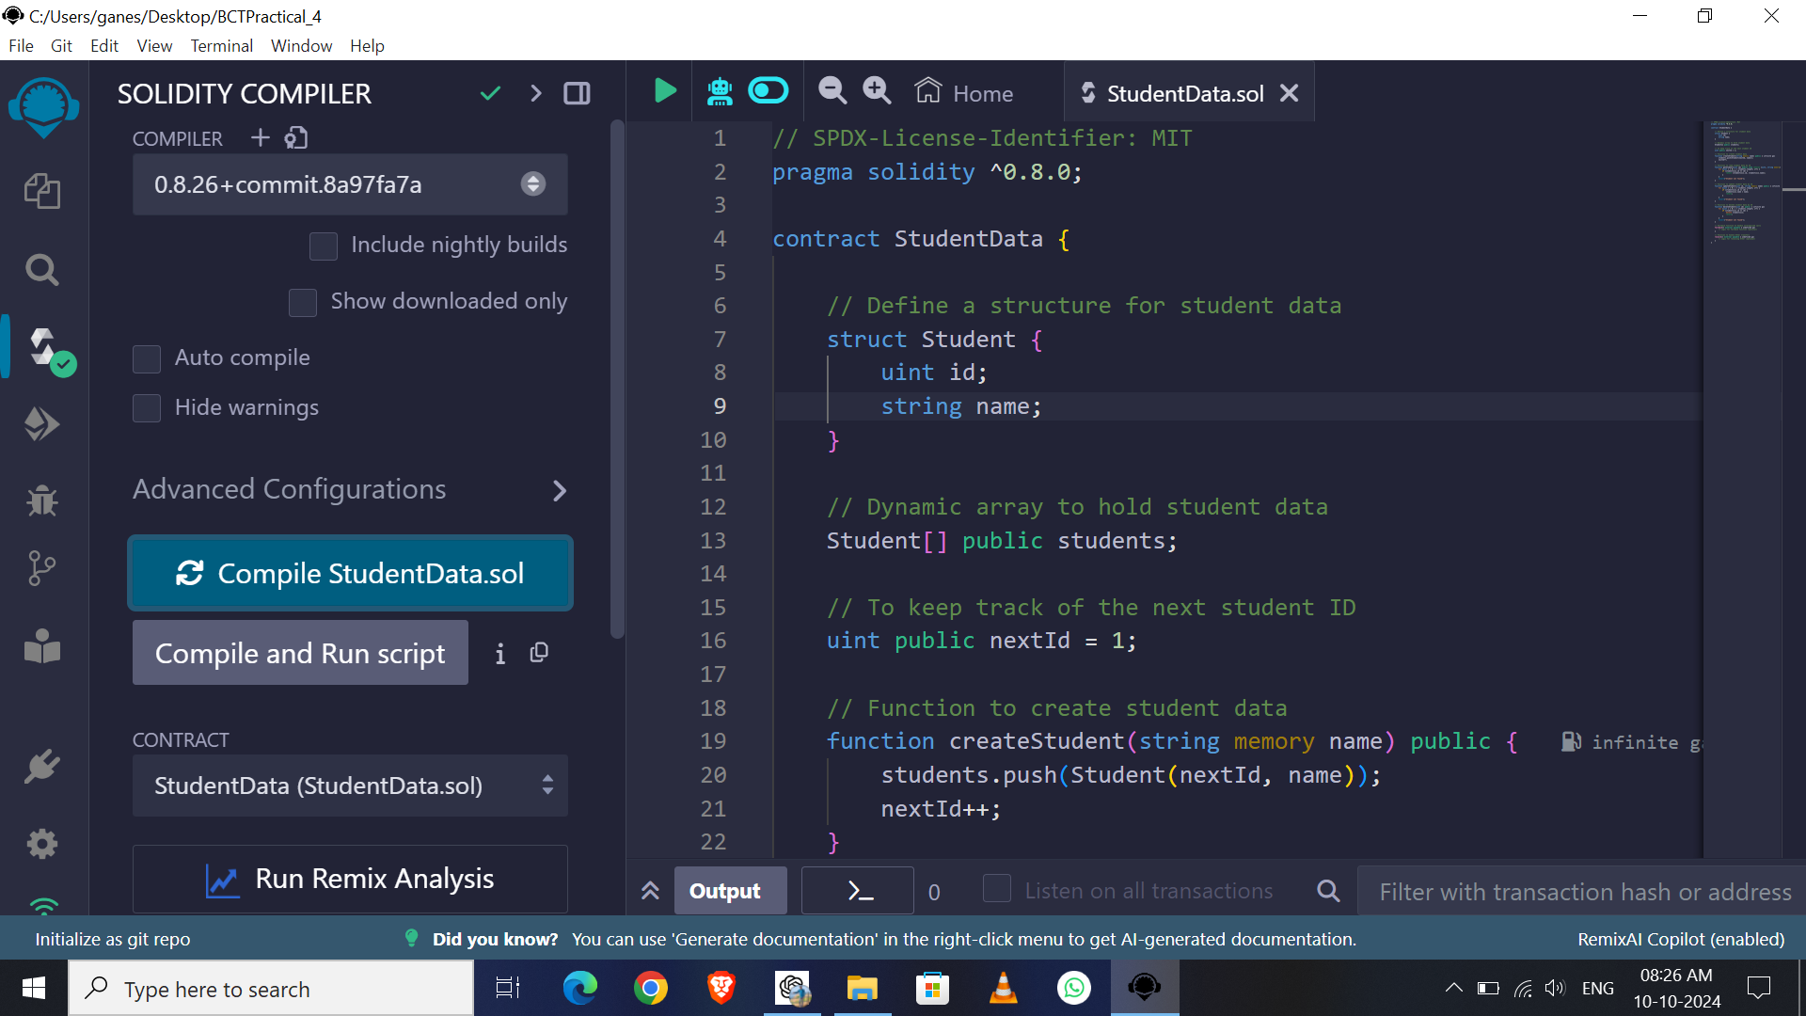

Slide 7
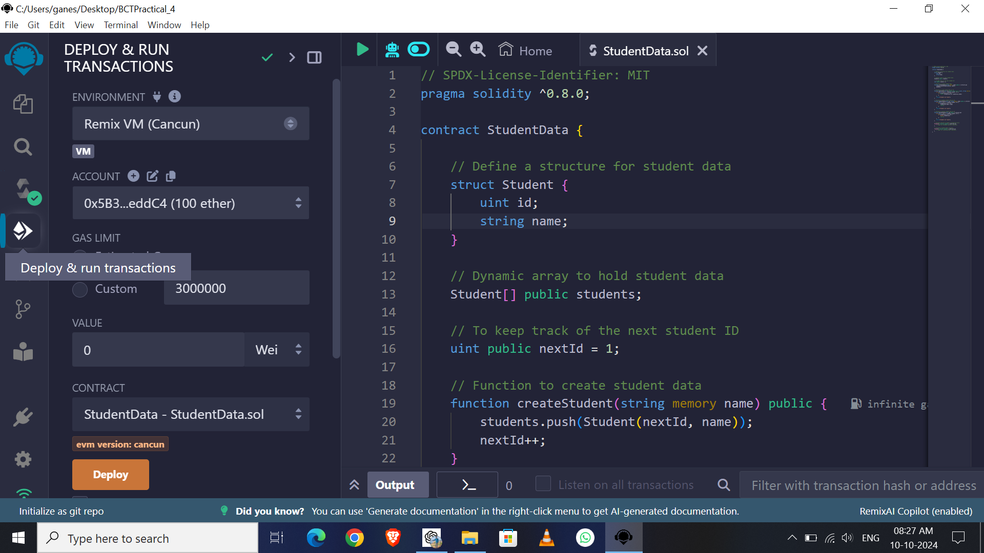

Slide 8
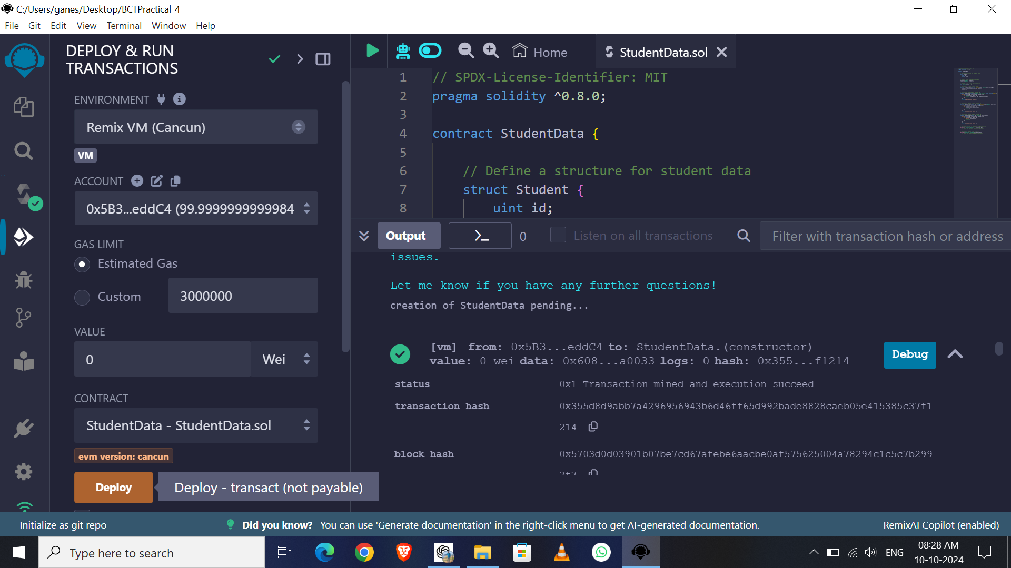

Slide 9
Add Student

Slide 10
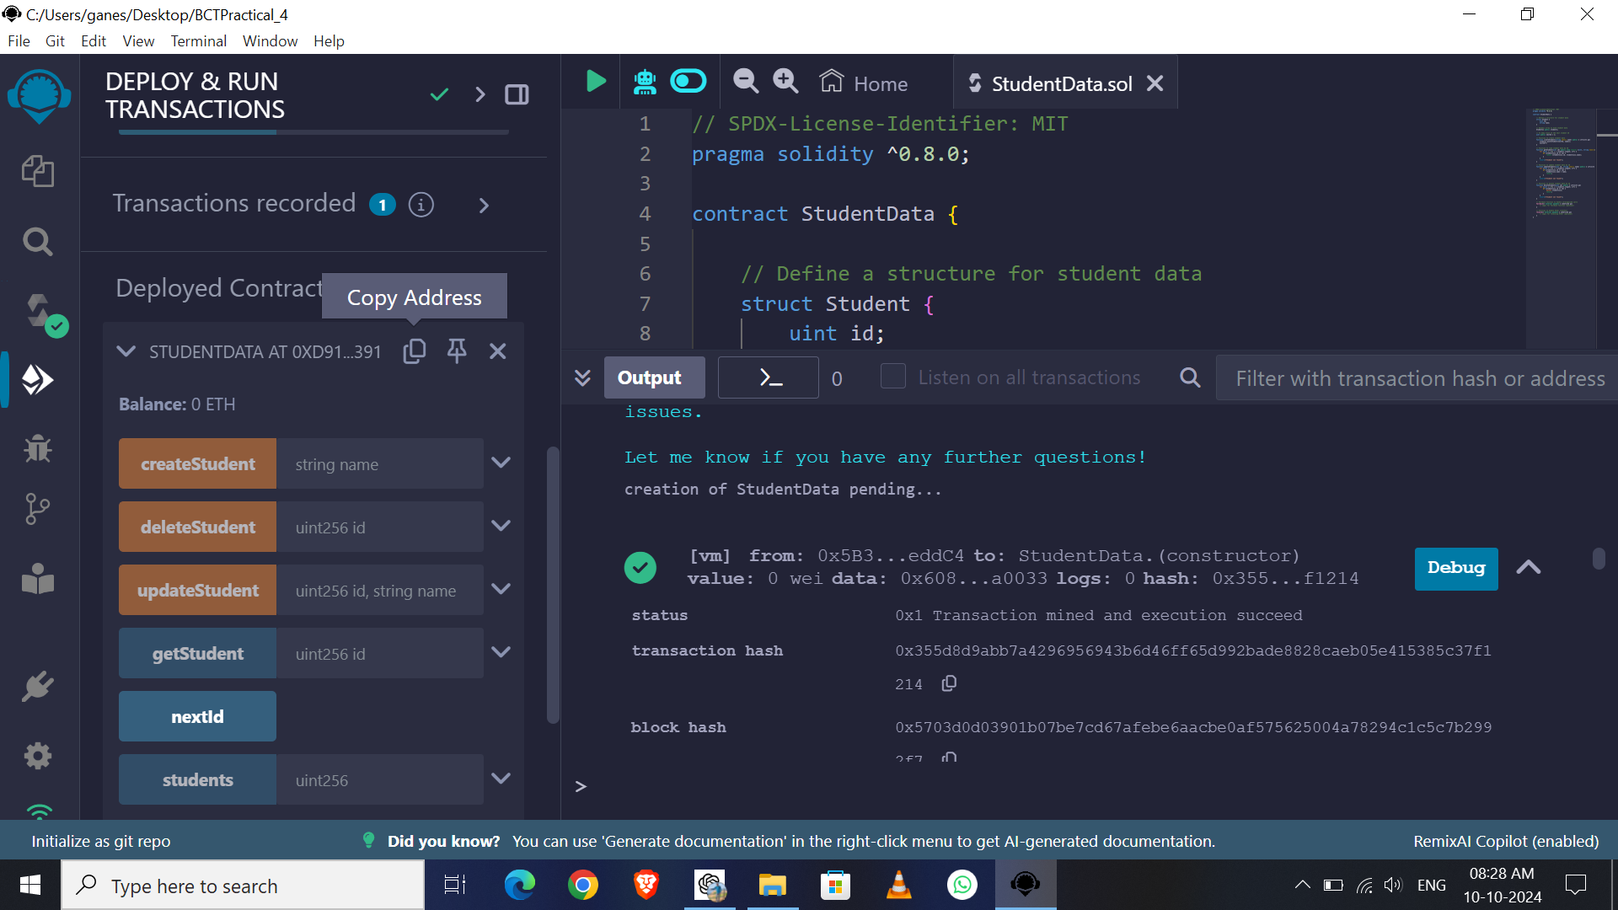

Slide 11
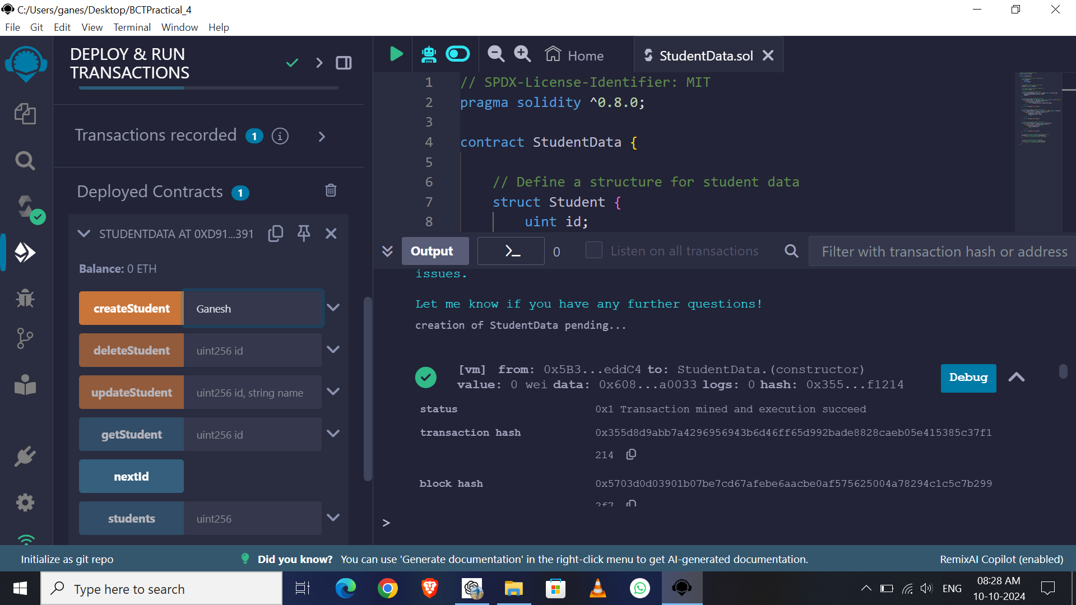
Enter Name of Student & Click On createStudent Button

Slide 12
We can add More than One
Students also
Now I am added only One

Slide 13
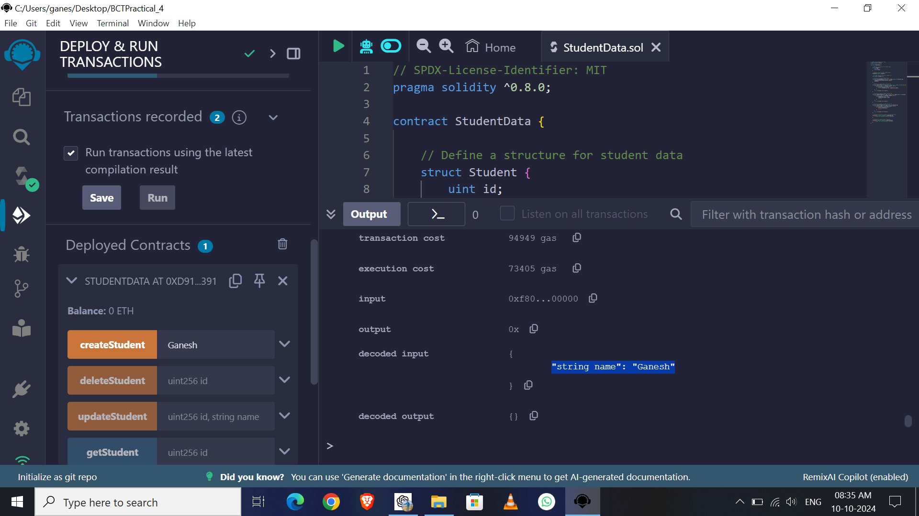

Slide 14
Read Student

Slide 15
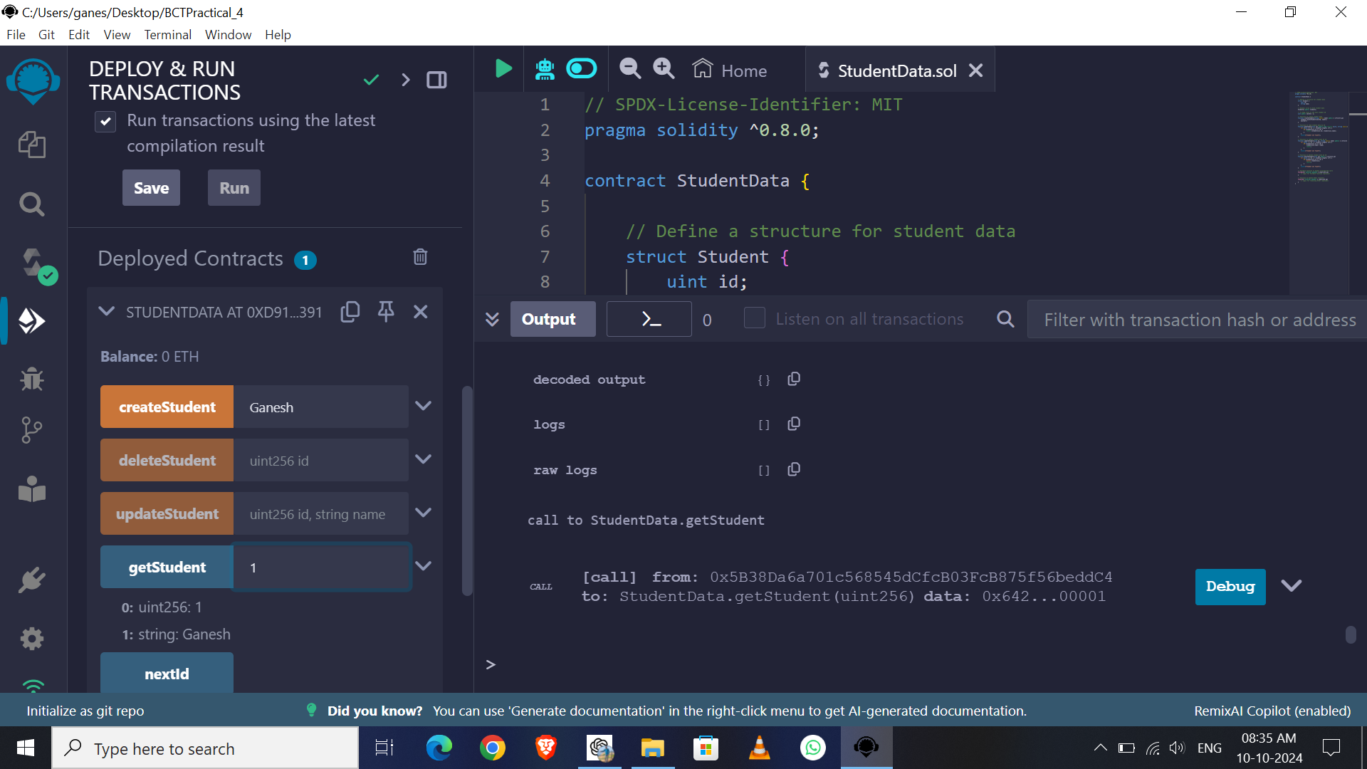

Slide 16
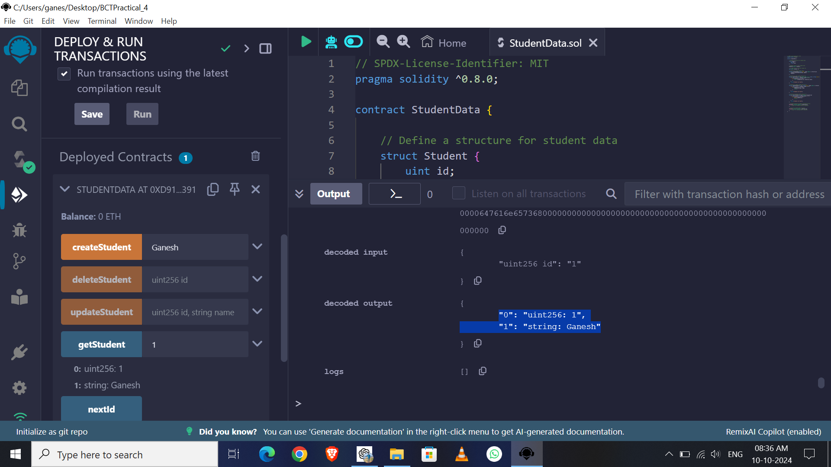
Enter ID of Student & Click On getStudent Button
To retrieve the student information & Check in CONSOL
Ex: 1 (because I added only 1 student)

Slide 17
Update Student

Slide 18
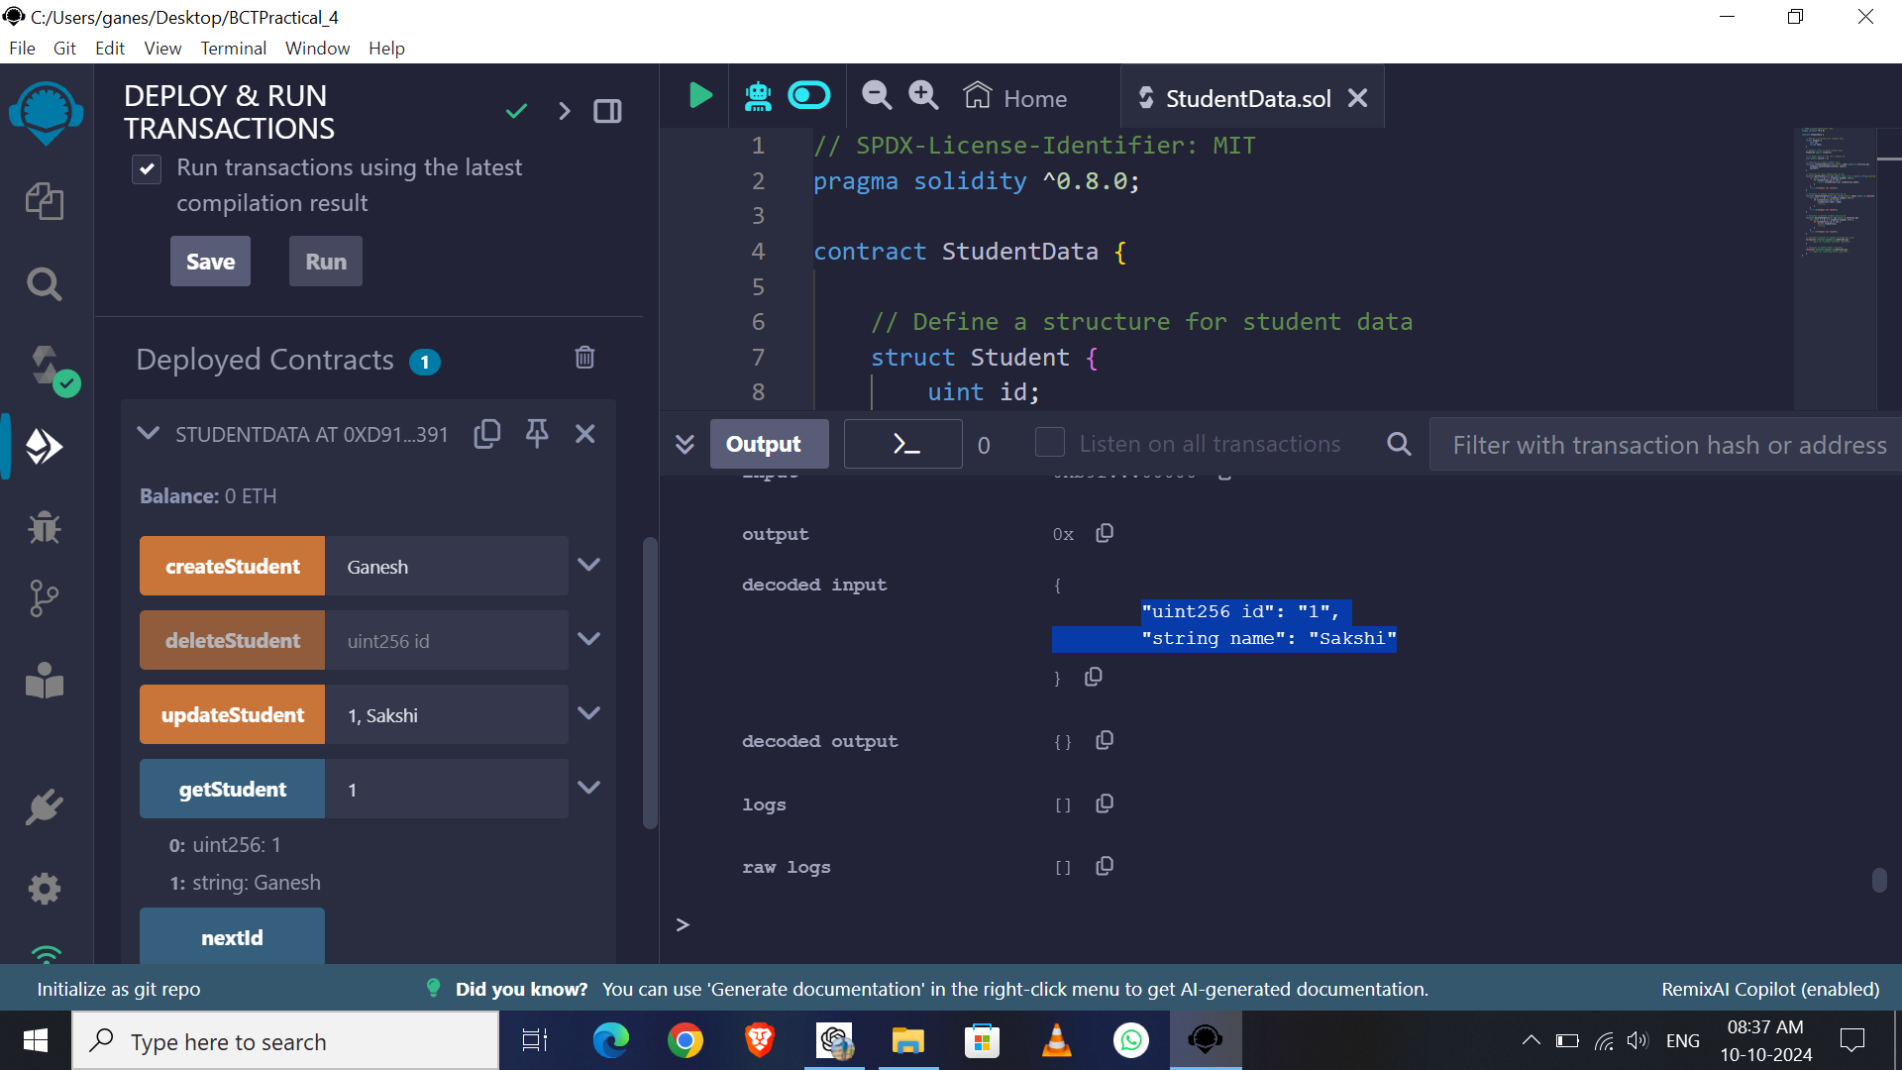
Enter ID of Student with new name & Click On updateStudent Button
To retrieve the student information & Check in CONSOL
For Ex: 1,Sakshi

Slide 19
Delete Student

Slide 20
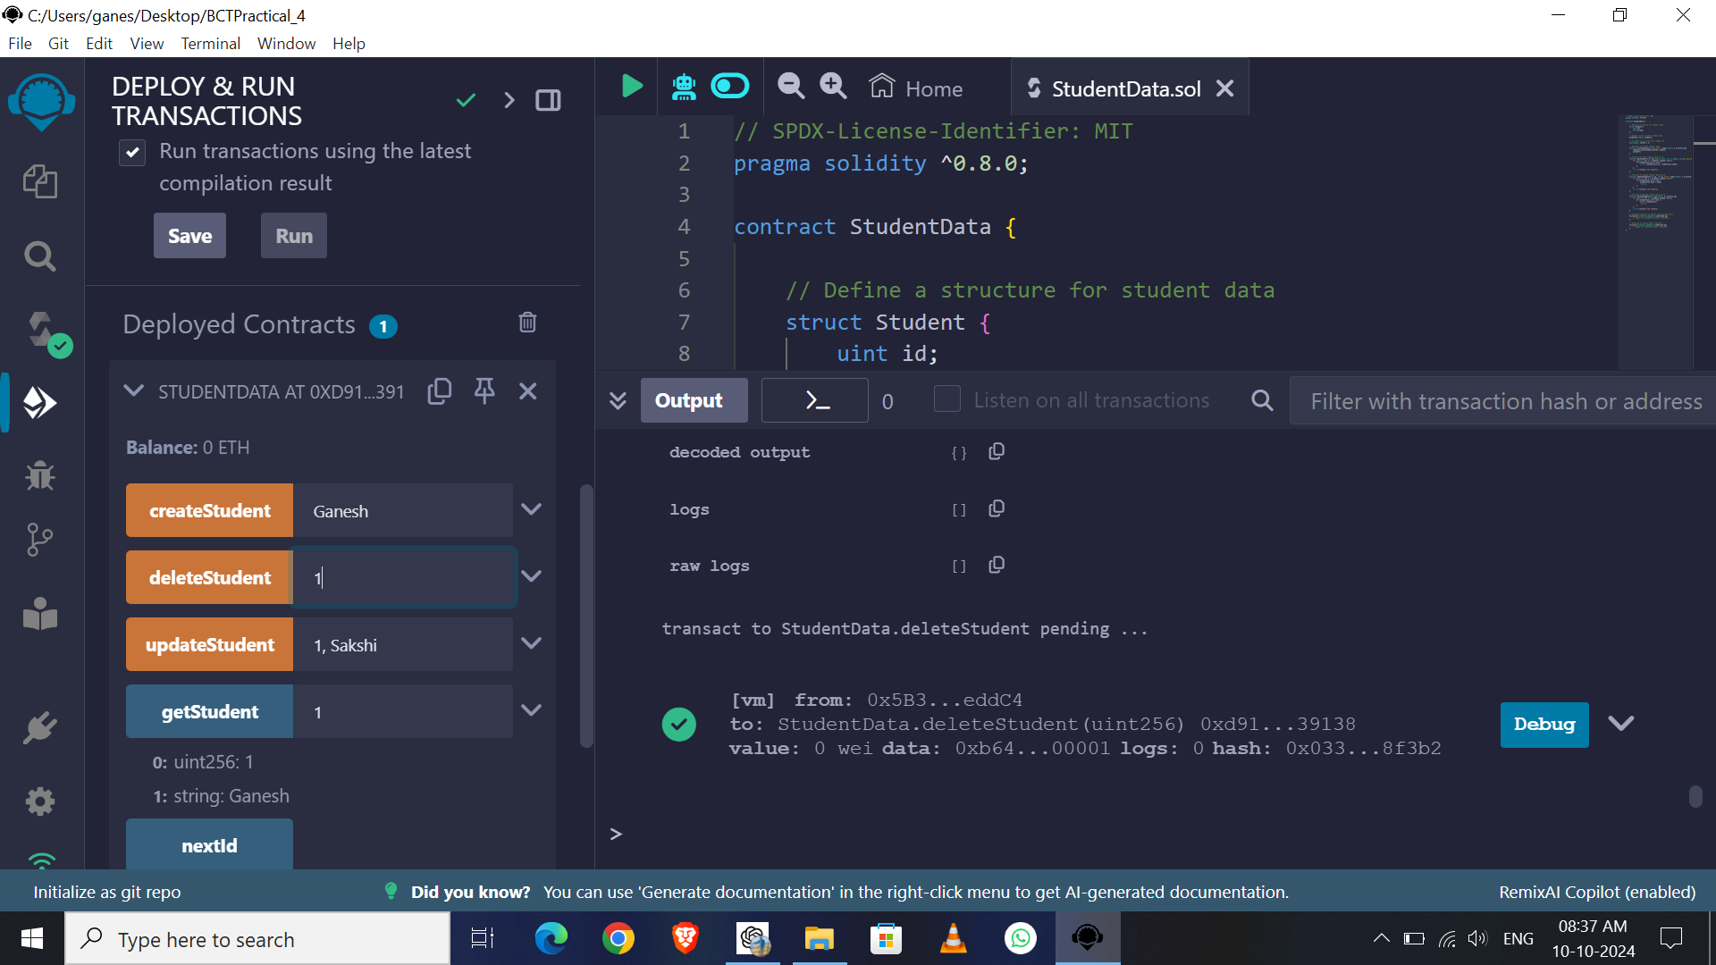
Enter ID of Student & Click On deleteStudent Button
To retrieve the student information & Check in CONSOL
For Ex: 1

Slide 21
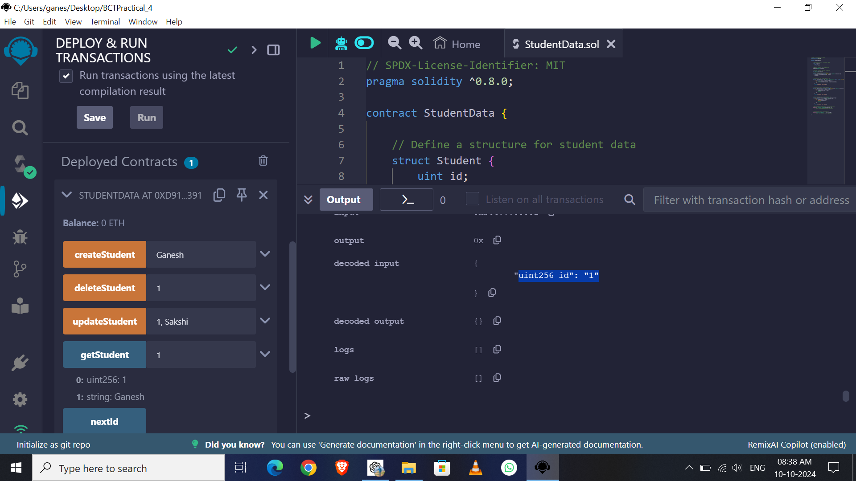
Now ID 1 Student is Deleted check the CONSOL

Slide 22
Observe Transaction
and Gas Fees
of all operations
In CONSOL

Slide 23
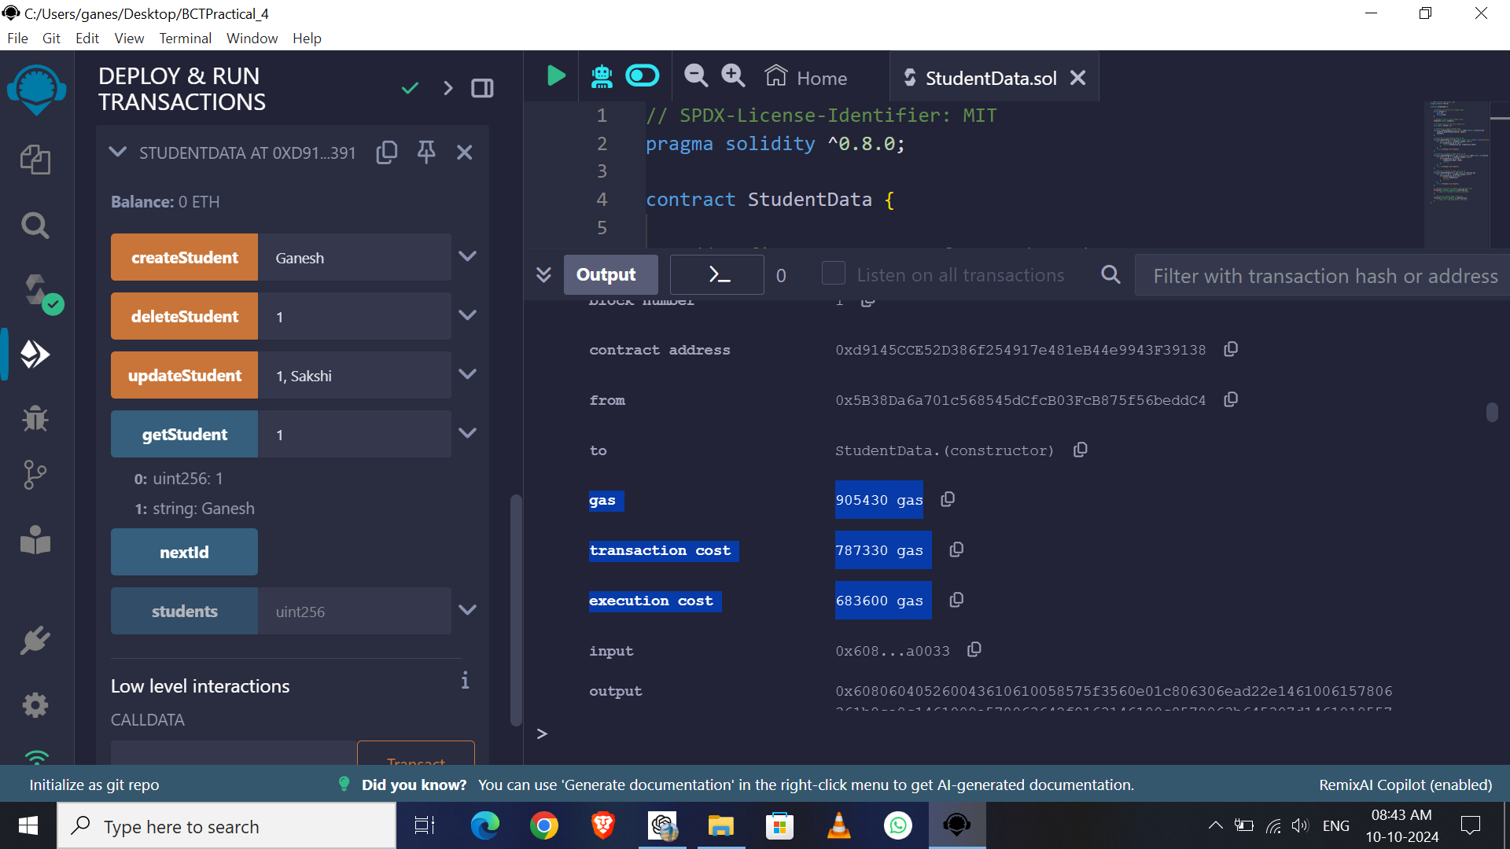

Slide 24
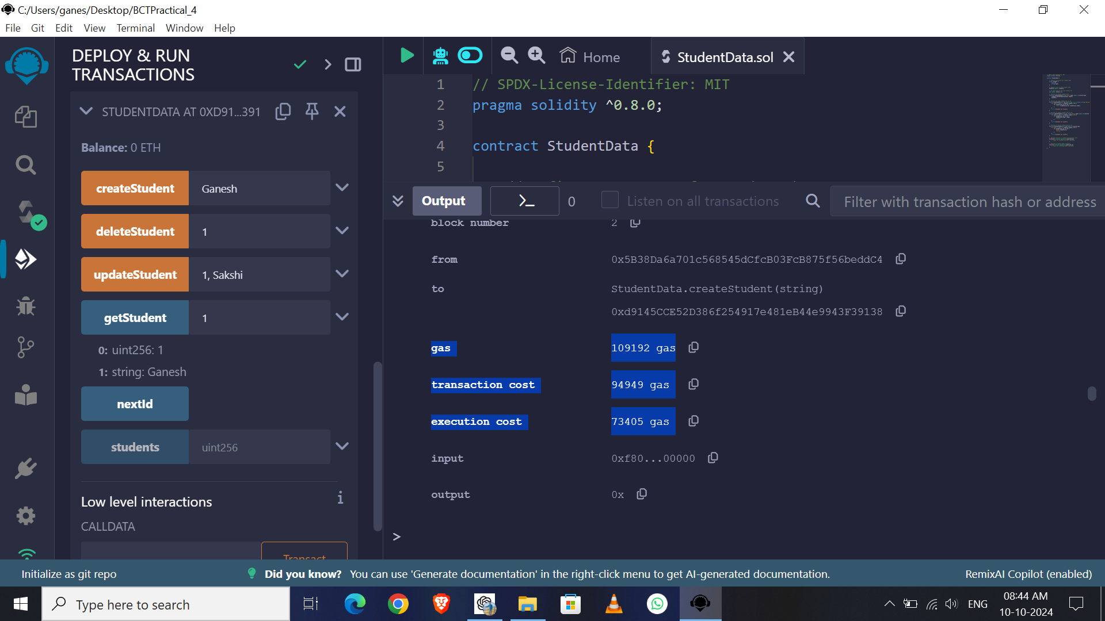

Slide 25
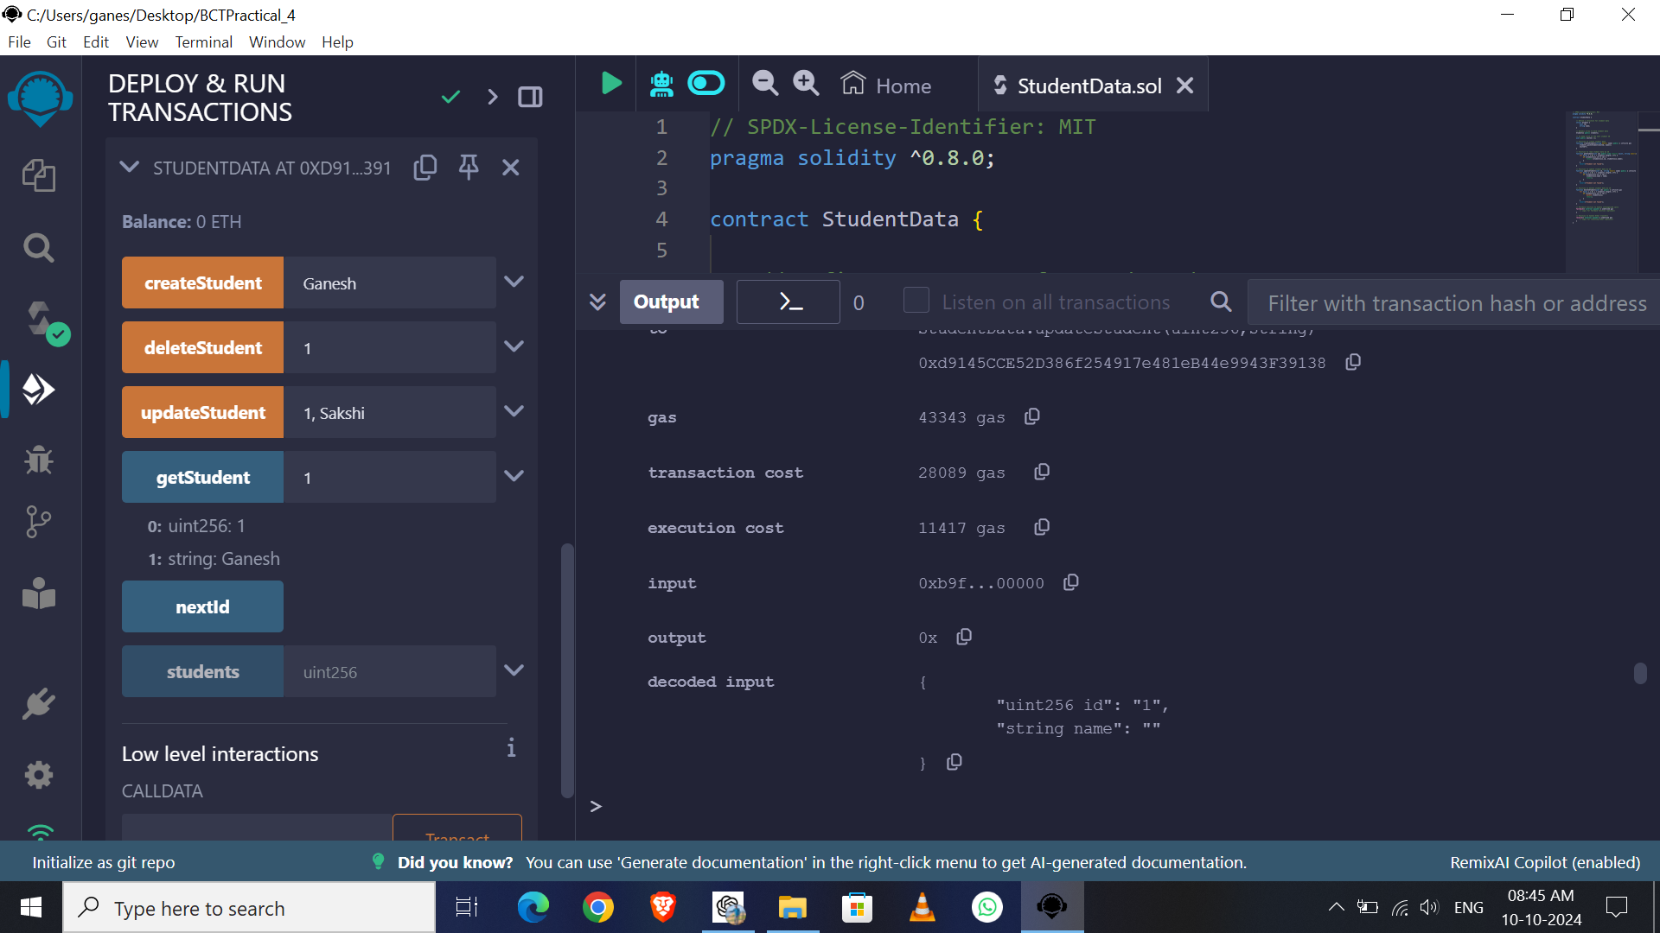

Slide 26
Check the Fallback
Function is Working?

Slide 27
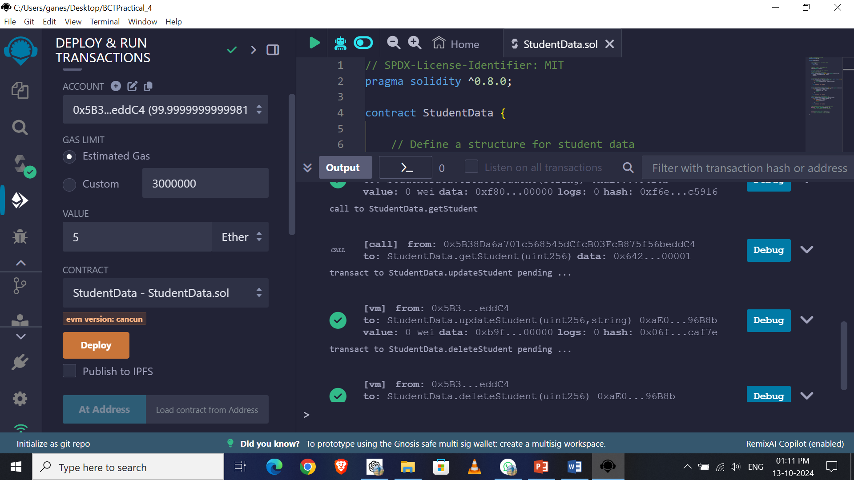
Enter Amount Of Ether 5 ETH & Choose Unit as Ether

Slide 28
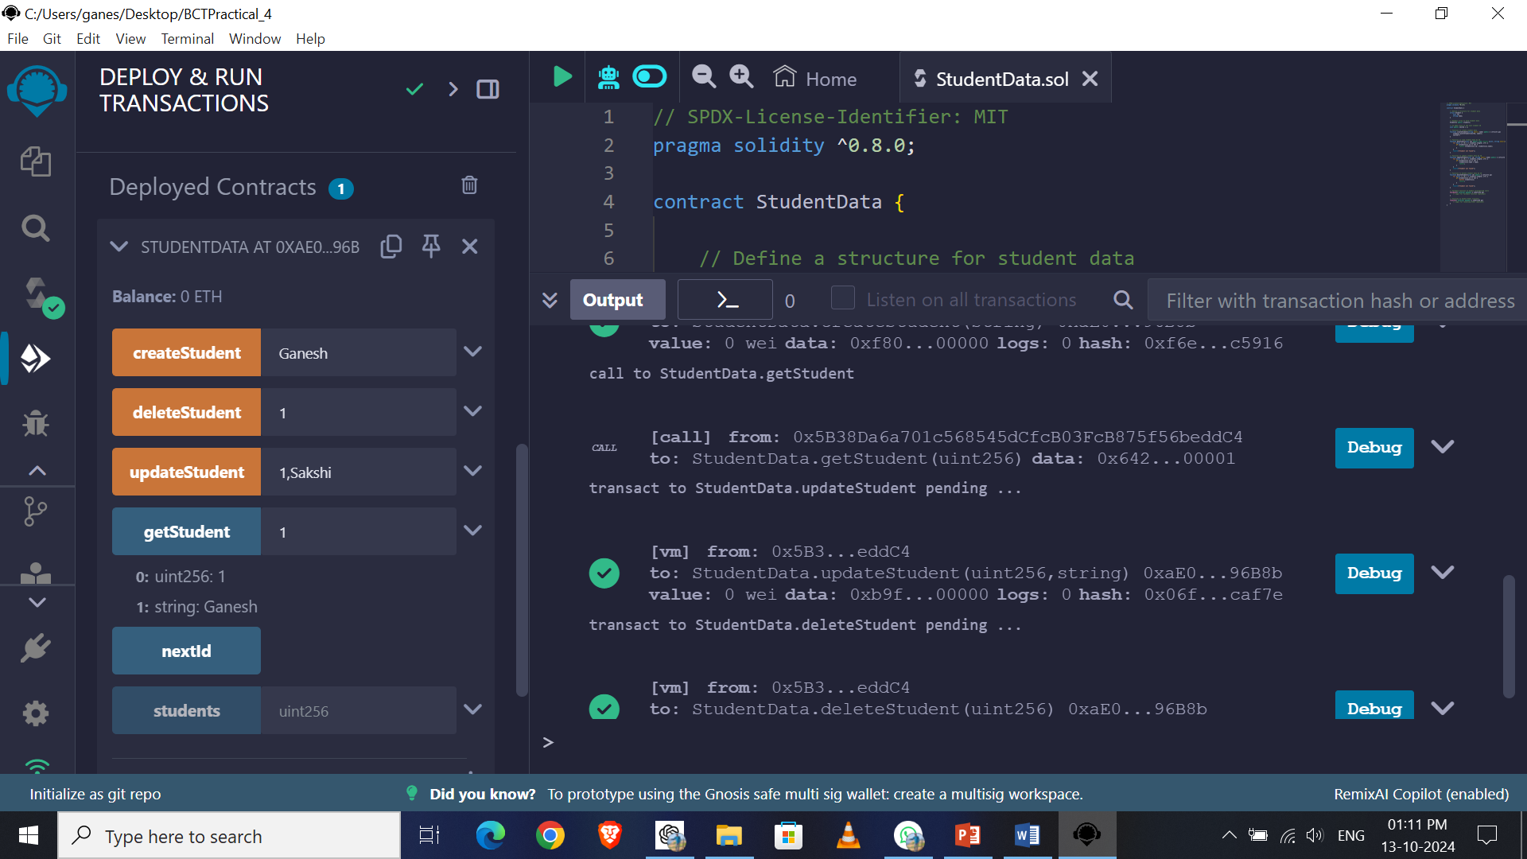
Check the Current Balance is 0 ETH

Slide 29
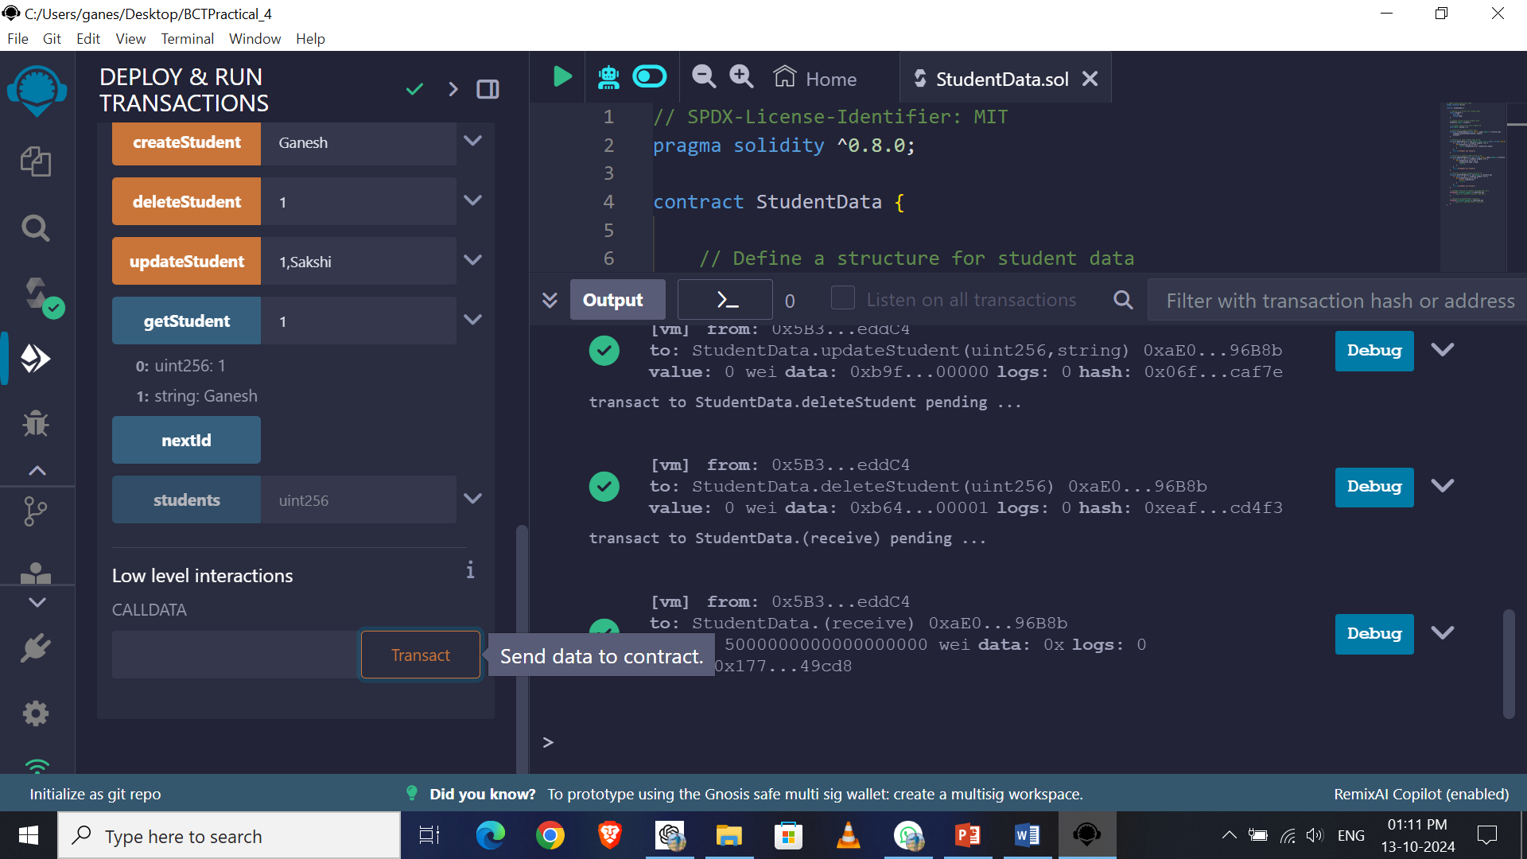
Click On Transact Button

Slide 30
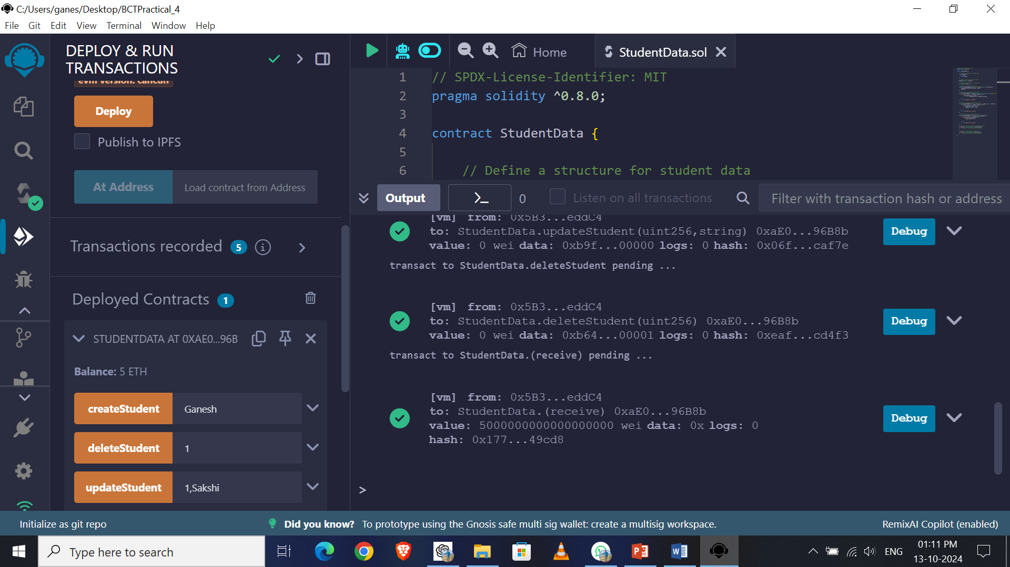
Now Check the Current Balance is 5 ETH Received

Slide 31
We can also Check the
Fallback Function using
following way

Slide 32
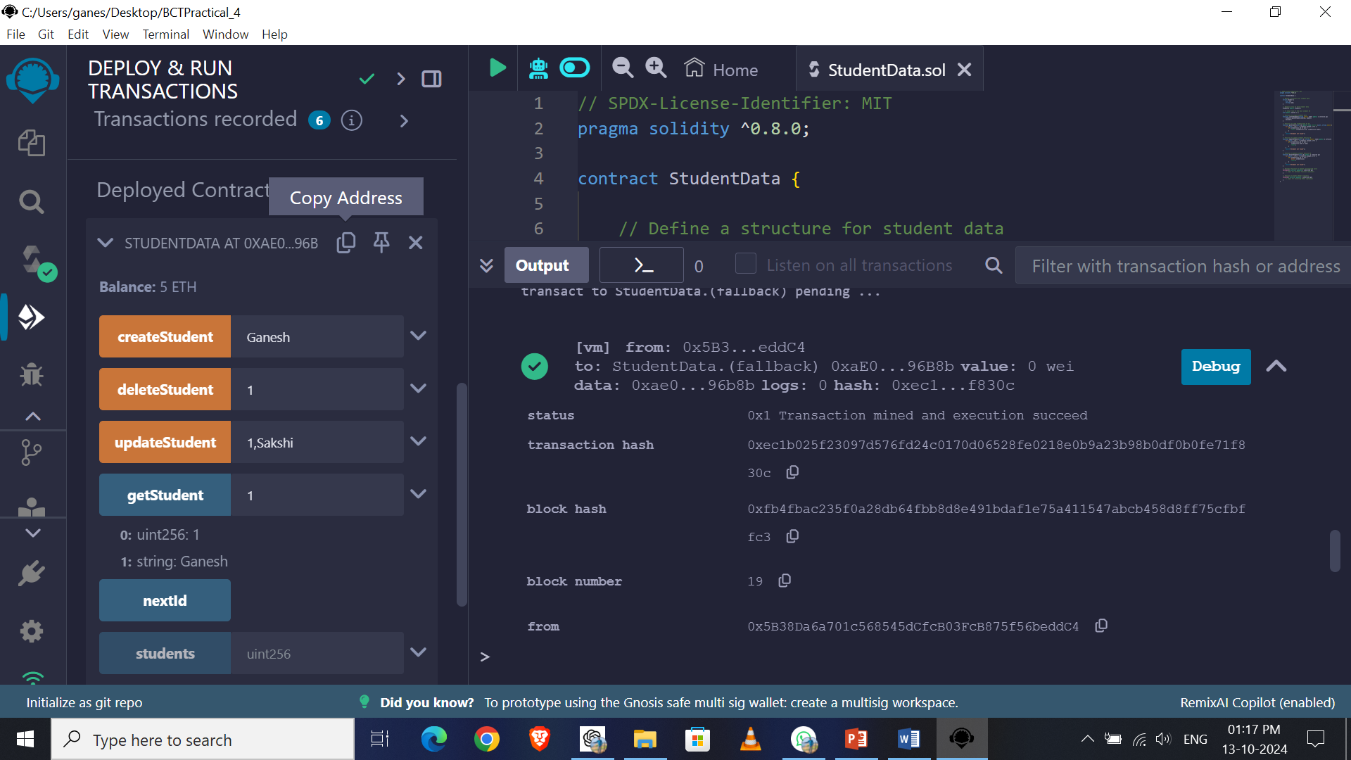
Copy the Address

Slide 33
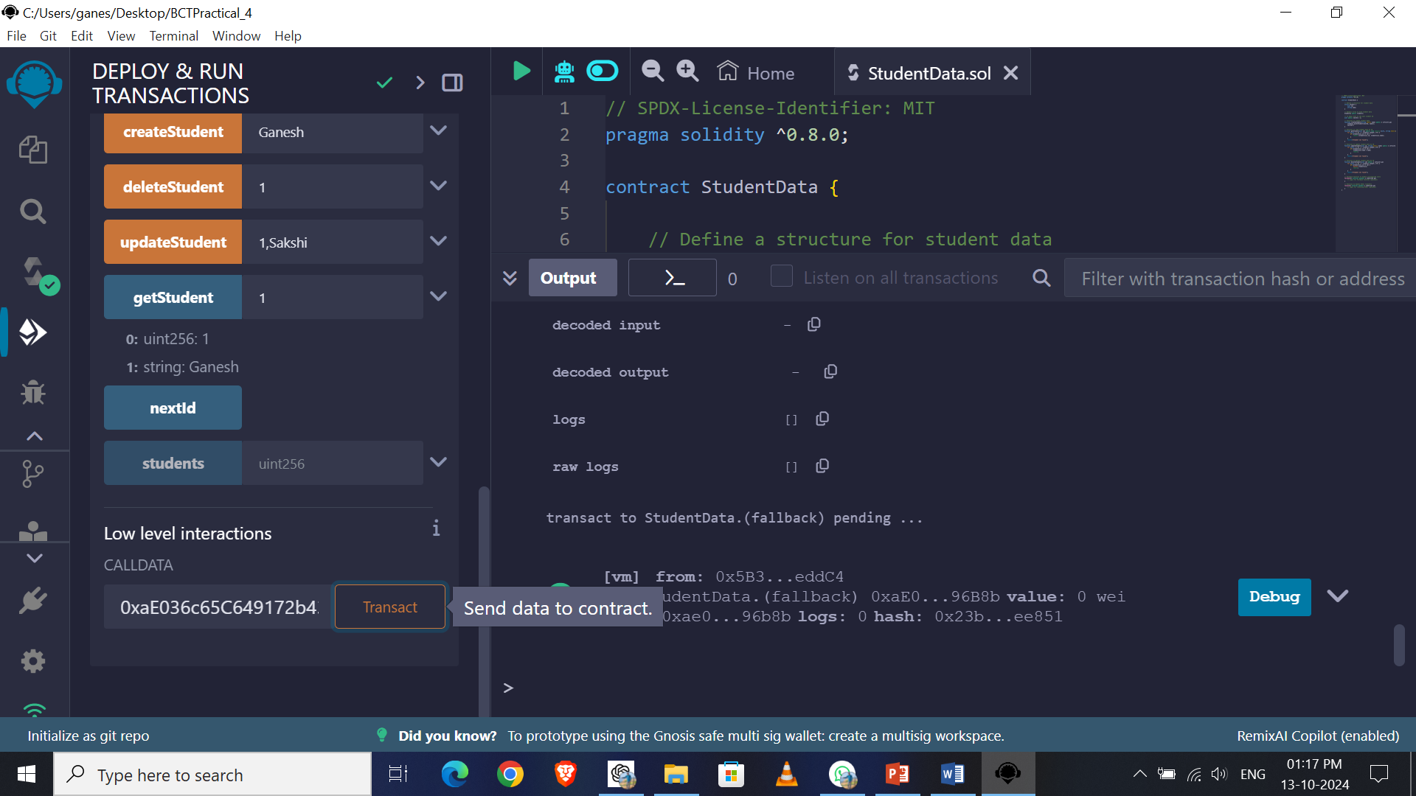
Past the Address here & Click on Transact Button

Slide 34
Check the Log in CONSOL

Slide 35


